Slide 1
ECE1786
Creative Applications of
Natural Language Processing
Project Proposal: “Eng2Py”
Dhairya Parmar
Yuchen Dai
Notes:
Good Evening everyone, myself Dhairya with my teammate Yuchen, here to propose our project “Eng2Py”

Slide 2

Introduction
What is the first thing you do when you get stuck while writing code?
Searching solutions on StackOverflow is time consuming
Since Python is technically a Language, can we generate code using Natural Language Processing?
Goal: To generate code solutions to basic python problems pertaining to sorting algorithms using natural language queries
Notes:
As a programmer you must have came across a situation where you feel the need to look up code due to syntax errors or unfamiliarity of the library in use.
Instinctively you’ll go on google, search your problem and in most cases would get the solution from a StackOverflow post. But this approach is time consuming and you never get the exact solution to your problem,
What if there was a way to generate code using natural language commands directly in the environment you are working in?
This notion is the prime motivation of our project.
Goal
The purpose of focusing on sorting problems is to explore if the language model can learn a specific class of problems better

Slide 3
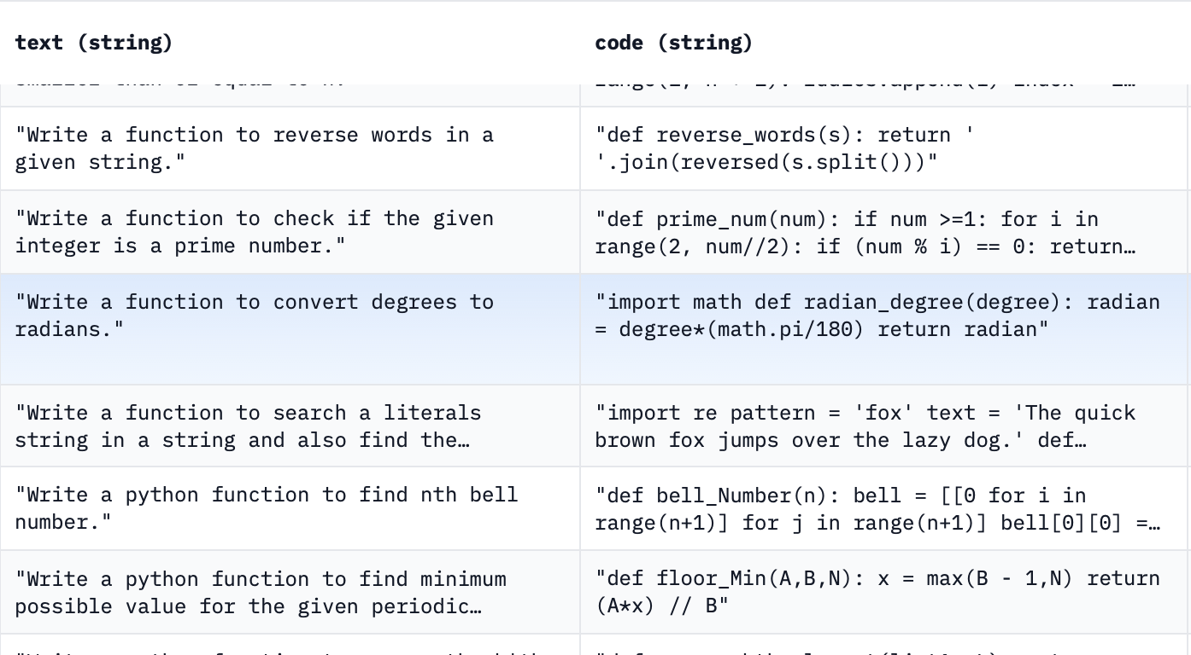
Datasets and Data Collection
Hugging Face - Mostly Basic Python Problems
Notes:
Coming to Data, One of the Data Sources in this project is a dataset from Huggingface named mostly basic python problems
It contains short Python functions designed to be solved by entry-level programmers and text descriptions of those programs

Slide 4
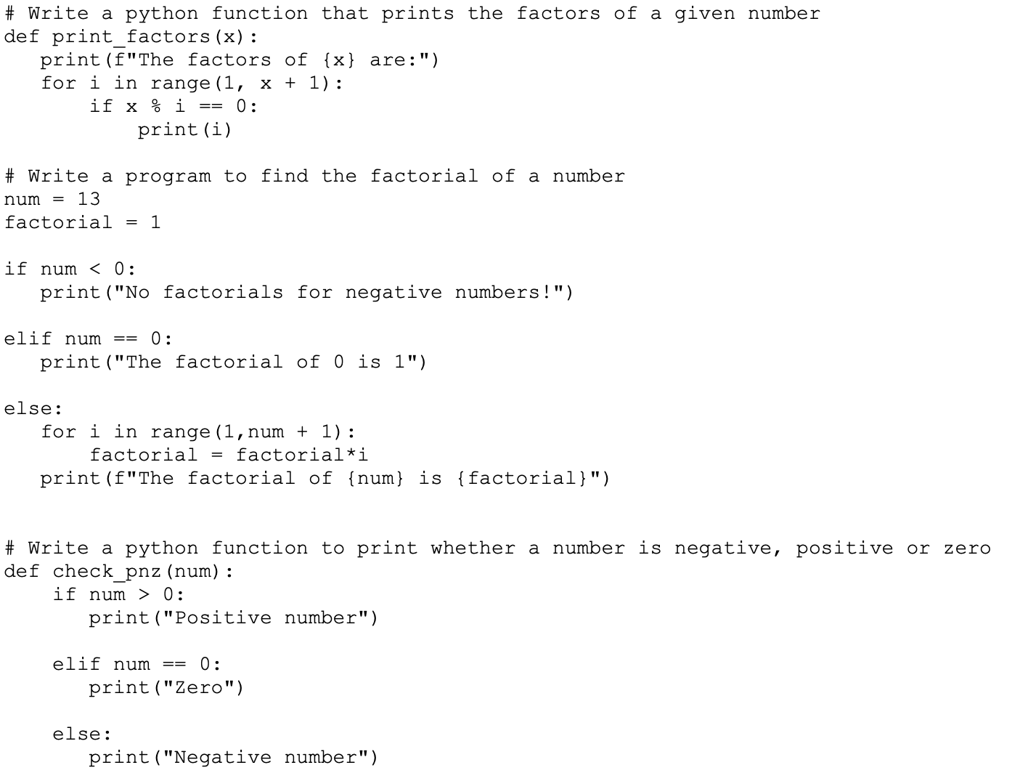
Datasets and Data Collection
Custom Dataset curated by The School of AI
Data Labeling Strategy:
Searching basic python problems associated to sorting algorithms
Labelling them in a compatible format
Notes:
Another data source is a custom dataset curated by The School of AI, an AI study and research platform,
This dataset is very similar to Mbpp and both sets can easily be concatenated to form a larger training set.
Finally, our data collection strategy concludes with finding problems associated to sorting algorithms and labeling them in a compatible format.
A data sample in the training set would be an input - target tuple, both strings, with input being the problem statement in English and target being the solution in python hence the name “Eng2Py”

Slide 5
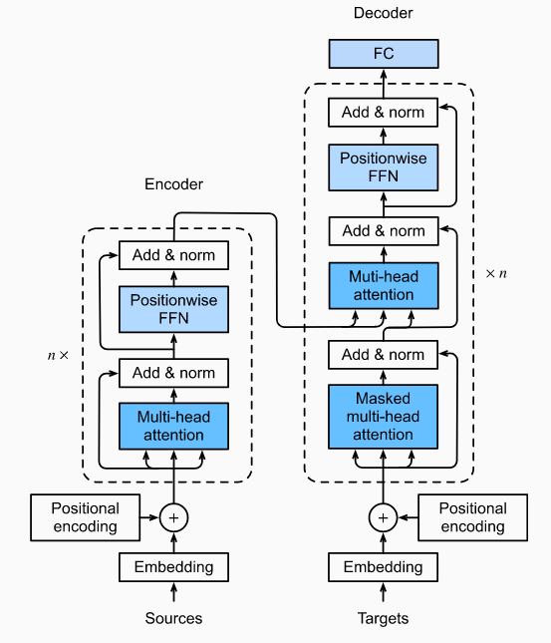
Neural Net Architecture & Baseline Comparison
Encoder - Decoder Transformer Model, Vaswani et al.
Baseline Model comparison:
May not include a baseline model
Hand-label each output based on completeness and correctness
Notes:
The anticipated model architecture for this project is an Encoder-Decoder Transformer, which can be visualised according to this image from the original vaswani paper,
We are going to pre-train the model with all kinds of python codes and then fine-tune it with the samples corresponding to sorting problems only.
Since it is not clear what a simple baseline model is in case of code generation problem, we may not include a baseline model.
A baseline comparison that can be used is searching with the same input on StackOverflow and compare with the result of our model.
Regardless, we will have to hand-label each output based on their completeness and correctness, and specify if the results are acceptable to indicate the quality of the model.

Slide 6

Risks
Unexpected events
Schedule Buffer
Potential time wasting during the training process
Reasonable task arrangement
Notes:
There are several risks that may lead to problems.
The first one is the unexpected events. Since changes may go beyond our plan, we have reserved a schedule buffer which can be flexibly used.
However, if everything keeps up with the plan, then we could use this time to further improve the things we already have.
Another risk is the potential time wasting during the training process.
Since limited things can be done while waiting for training, we plan to create the model as soon as possible to start training so that we can prepare for the progress report at the same time.

Slide 7
Plan
Data Collection/Labeling – Nov 02 - Nov 05 (3 - 4 days)
Programming the Model Architecture – Nov 14 - Nov 21
(7 - 8 days)
Progress Report – Nov 20 - Nov 21 (1 - 2 days)
Notes:
We are planning to finish data collection/labeling and model creation before 21st, Nov.
Like I mentioned earlier that we arrange to complete the model first to start training while preparing for the report.

Slide 8
Thank you!

